Slide 1
Triggers
trigger defines an action the database should take when some database-related event occurs.

Slide 2
Triggers
Triggers are procedures that are stored in the database and are implicitly run, or fired, when something happens.
Triggers may be used to supplement declarative referential integrity, to enforce complex business rules, or to audit changes to data.
The code within a trigger, called the trigger body, is made up of PL/SQL blocks
The execution of triggers is transparent to the user.
Triggers are executed by the database when specific types of data manipulation commands are performed on specific tables. Such commands may include:
inserts, updates, and deletes
Triggering events may also include DDL commands and database events such as shutdowns and logins

Slide 3
When to use Triggers
Because of their flexibility, triggers may supplement referential integrity; they should not be used to replace it.
When enforcing the business rules in an application, you should first rely on the declarative referential integrity available with Oracle;
use triggers to enforce rules that cannot be coded through referential integrity.
A trigger is either a stored PL/SQL block or a PL/SQL, C, or Java procedure associated with a table, view, schema, or the database itself
Types of Triggers
DML triggers (DELETE, INSERT, UPDATE)
Row-Level Triggers
Statement-Level Triggers
BEFORE and AFTER Triggers
INSTEAD OF Triggers
Schema Triggers
Database-Level Triggers
Compound Triggers (Oracle 11g)

Slide 4
System Events
You can create triggers to be fired on any of the following:
DML statements (DELETE, INSERT, UPDATE)
DDL statements (CREATE, ALTER, DROP)
Database operations (SERVERERROR, LOGON, LOGOFF, STARTUP, SHUTDOWN)
Creating a trigger on SCHEMA implies that the trigger is created in the current user's schema and is fired only for that user.
Creating a trigger on DATABASE implies that the triggering event is outside the scope of a user and it applies to all users

Slide 5
When Is the Trigger Fired?
A trigger is fired based on a triggering statement, which specifies:
The SQL statement or the system event, database event, or DDL event that fires the trigger body.
The options include DELETE, INSERT, and UPDATE. One, two, or all three of these options can be included in the triggering statement specification.
The table, view, DATABASE, or SCHEMA associated with the trigger.
The PRINT_SALARY_CHANGES trigger fires after any DELETE, INSERT, or UPDATE on the Emp_tab table
CREATE OR REPLACE TRIGGER Print_salary_changes
BEFORE DELETE OR INSERT OR UPDATE ON Emp_tab
FOR EACH ROW
WHEN (new.Empno > 0)
DECLARE
sal_diff number;
BEGIN
sal_diff := :new.sal - :old.sal;
dbms_output.put('Old salary: ' || :old.sal);
dbms_output.put(' New salary: ' || :new.sal);
dbms_output.put_line(' Difference ' || sal_diff);
END;

Slide 6
Row level vs. Statement level Triggers
FOR EACH ROW Trigger
statement Trigger
The FOR EACH ROW option determines whether the trigger is a row trigger or a statement trigger.
If you specify FOR EACH ROW, then the trigger fires once for each row of the table that is affected by the triggering statement.
CREATE OR REPLACE TRIGGER Log_salary_increase
AFTER UPDATE ON Emp_tab
FOR EACH ROW
WHEN (new.Sal > 1000)
BEGIN
INSERT INTO Emp_log (Emp_id, Log_date, New_salary, Action)
VALUES (:new.Empno, SYSDATE, :new.SAL, 'NEW SAL');
END;
The following trigger fires only once for each UPDATE of the Emp_tab table:
CREATE OR REPLACE TRIGGER Log_emp_update
AFTER UPDATE ON Emp_tab
BEGIN
INSERT INTO Emp_log (Log_date, Action)
VALUES (SYSDATE, 'Emp_tab COMMISSIONS CHANGED');
END;

Slide 7
Trigger Syntax Example: auditing triggers.
create or replace trigger BOOKSHELF_BEF_UPD_ROW
before update on BOOKSHELF
for each row
when (new.Rating < old.Rating)
begin
insert into BOOKSHELF_AUDIT
(Title, Publisher, CategoryName, Old_Rating, New_Rating, Audit_Date)
values
(:old.Title, :old.Publisher, :old.CategoryName, :old.Rating, :new.Rating, Sysdate);
end;
Trigger Name: BOOKSHELF_BEF_UPD_ROW
Trigger Naming Convention
Use table name in the name of the trigger
Event Name: before update
Trigger Naming Convention
Use event name in the name of the trigger
Applies To: for each row
the trigger will apply to each row changed by the update statement
Further Criteria: use the when clause
Condition in the when clause must also be true for the trigger to fire
Reference old values with OLD clause and new ones with the NEW clause.
When the new and old keywords are referenced in the PL/SQL block, they are preceded by colons (:).
Trigger Body: actions to take
This example inserts the old values from the BOOKSHELF record into the BOOKSHELF_AUDIT table before the BOOKSHELF record is updated.

Slide 8
Combining DML Trigger Types
create or replace trigger BOOKSHELF_BEF_UPD_INS_ROW
before insert or update of Rating on BOOKSHELF
for each row
begin
if INSERTING then
insert into BOOKSHELF_AUDIT (Title, Publisher, CategoryName, New_Rating, Audit_Date)
Values (:new.Title, :new.Publisher, :new.CategoryName, :new.Rating, Sysdate);
else -- if not inserting then we are updating the Rating
insert into BOOKSHELF_AUDIT (Title, Publisher, CategoryName, Old_Rating, New_Rating, Audit_Date)
Values (:old.Title, :old.Publisher, :old.CategoryName, :old.Rating, :new.Rating, Sysdate);
end if;
end;
trigger is executed whenever an insert or an update occurs.
The update portion of the trigger occurs only when the Rating column’s value is updated.
BEFORE INSERT and BEFORE UPDATE (of Rating) trigger
Valid transaction types are INSERTING, DELETING, and UPDATING

Slide 9
Customizing Error Conditions
create or replace trigger BOOKSHELF_BEF_DEL
before delete on BOOKSHELF
declare
weekend_error EXCEPTION;
not_library_user EXCEPTION;
begin
if TO_CHAR(SysDate,'DY') = 'SAT' or TO_CHAR(SysDate,'DY') = 'SUN' THEN
RAISE weekend_error;
end if;
if SUBSTR(User,1,3) <> 'LIB' THEN
RAISE not_library_user;
end if;
EXCEPTION
WHEN weekend_error THEN RAISE_APPLICATION_ERROR (-20001, 'Deletions not allowed on weekends');
WHEN not_library_user THEN RAISE_APPLICATION_ERROR (-20002, 'Deletions only allowed by Library users');
end;
There are no when clauses in this trigger, so the trigger body is executed for all deletes.
Within a single trigger, you may establish different error conditions.
For each of the error conditions you define, you may select an error message that appears when the error occurs.
Error numbers and messages that are displayed to the user are set via the RAISE_APPLICATION_ERROR procedure, which may be called from within any trigger.
The following example shows a statement-level BEFORE DELETE trigger on the BOOKSHELF table.
When a user attempts to delete a record from the BOOKSHELF table, this trigger is executed and checks two system conditions:
that the day of the week is neither Saturday nor Sunday, and
that the Oracle username of the account performing the delete begins with the letters “LIB.”

Slide 10
Calling Procedures Within Triggers
create or replace trigger BOOKSHELF_AFT_INS_ROW
after insert on BOOKSHELF_AUDIT
for each row
begin
call INSERT_BOOKSHELF_AUDIT_DUP(:new.Title, :new.Publisher, :new.CategoryName, :new.Old_Rating, :new.New_Rating, :new.Audit_Date);
end;
Rather than creating a large block of code within a trigger body, you can save the code as a stored procedure and call the procedure from within the trigger, by using the call command.

Slide 11
Creating DDL Event Triggers
create or replace trigger CREATE_DB_OBJECT_AUDIT
after create on schema
begin
call INSERT_AUDIT_RECORD (ora_dict_obj_name);
end;
/
You can create triggers that are executed when a DDL event occurs
If you use the on schema clause, the trigger will execute for any new data dictionary objects created in your schema
The following example will execute a procedure named INSERT_AUDIT_RECORD whenever objects are created within your schema:

Slide 12
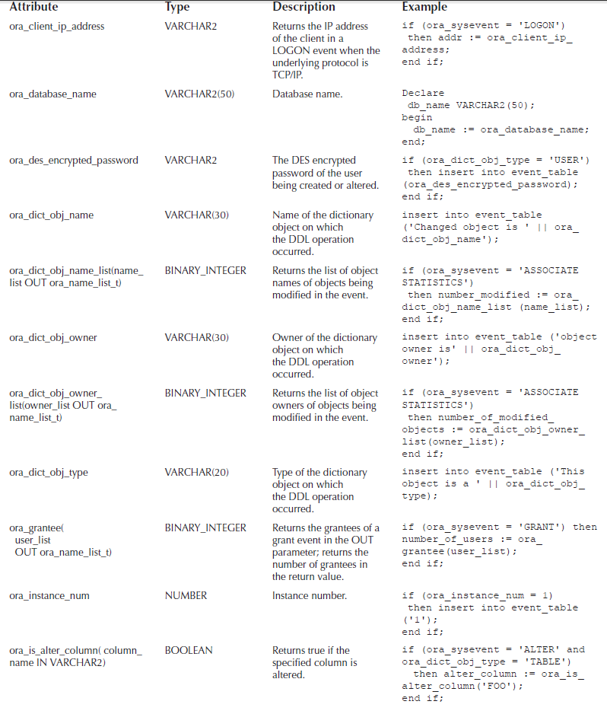
you can reference system attributes such as the object name.
The available attributes are listed in the Table

Slide 13
Protect Against Drop
create or replace trigger PREVENT_DROP
before drop on Practice.schema
begin
if ora_dict_obj_owner = 'PRACTICE'
and ora_dict_obj_name like 'BOO%'
and ora_dict_obj_type = 'TABLE'
then
RAISE_APPLICATION_ERROR (
-20002, 'Operation not permitted.');
end if;
end;
To protect the objects within a schema, you may want to create a trigger that is executed for each attempted drop table command.

Slide 14
Creating Database Event Triggers
create or replace trigger PREVENT_DROP
before drop on Practice.schema
begin
if ora_dict_obj_owner = 'PRACTICE'
and ora_dict_obj_name like 'BOO%'
and ora_dict_obj_type = 'TABLE'
then
RAISE_APPLICATION_ERROR (
-20002, 'Operation not permitted.');
end if;
end;
When a database event occurs (a shutdown, startup, or error), you can execute a trigger that references the attributes of the event (as with DDL events).
You could use a database event trigger to perform system maintenance functions immediately after each database startup.

Slide 15
Designing Triggers
Use triggers to guarantee that when a specific operation is performed, related actions are performed.
Do not define triggers that duplicate features already built into Oracle Database. For example, do not define triggers to reject bad data if you can do the same checking through declarative integrity constraints.
Limit the size of triggers. If the logic for your trigger requires much more than 60 lines of PL/SQL code, it is better to include most of the code in a stored procedure and call the procedure from the trigger.
Use triggers only for centralized, global operations that should be fired for the triggering statement, regardless of which user or database application issues the statement.
Do not create recursive triggers. For example, creating an AFTER UPDATE statement trigger on the Emp_tab table that itself issues an UPDATE statement on Emp_tab, causes the trigger to fire recursively until it has run out of memory.
Use triggers on DATABASE judiciously. They are executed for every user every time the event occurs on which the trigger is created.

